Slide 1

PREDICTION OF RAINFALL USING SVM TECHNIQUE Final Presentation By Vishakha Srivastava Suryansha Verma Shivam Shukla 130907162 130907013 130907023
Under the Guidance of
Mrs. Supreetha B.S
Assistant Professor Senior Scale
Dept. of E&C
MIT, Manipal
1

Slide 2
Contents
Objective
Literature survey
Methodology
Results
Conclusion
2

Slide 3
Objective
To predict rainfall for Udupi district using Support Vector Machine algorithm in R.
Rainfall prediction using different models namely :
linear model
SVR model
Tuned SVR
Comparison of all the models based on RMSE.

Slide 4
Literature Survey
PAPER TITLE | AUTHOR | CONCLUSION
1. Prediction of rainfall using support vector machine and relevance vector machine. | Venkata Ravibabu Mandala , Tarun Teja. | SVM has good generalization capability when compared to other algorithms.
2. A survey on rainfall prediction techniques. | Mr. Dhawal Hirani , Dr. Nitin Mishra. | Most of the prediction was carried out by applying ANN. Amongst all others SVM has the capability of predicting for non-linear data accurately.
3. Support vector regression machines, Advances in Neural Information Processing systems | Drucker, H. Burges, C. Kaufman, L. Smola A & Vapnik | 1.Understanding Regression in SVM 2. Advantages of SVR over other methods such as ANN.

Slide 5
METHODOLOGY
Step1: Reading secondary data
Step 2: Create a linear regression model using lm() function
Step 3: Display the prediction
Step 4: Predict RMSE
Step 5: Improvise existing model using SVR

Slide 6
Step 6: Predict new values using SVR
Step 7: Calculate RMSE for new values
Step 8: Tuning the SVR model using Gridsearch()
Step 9: Calculate RMSE based on C and ℇ
Step 10: Compare performance of the models

Slide 7
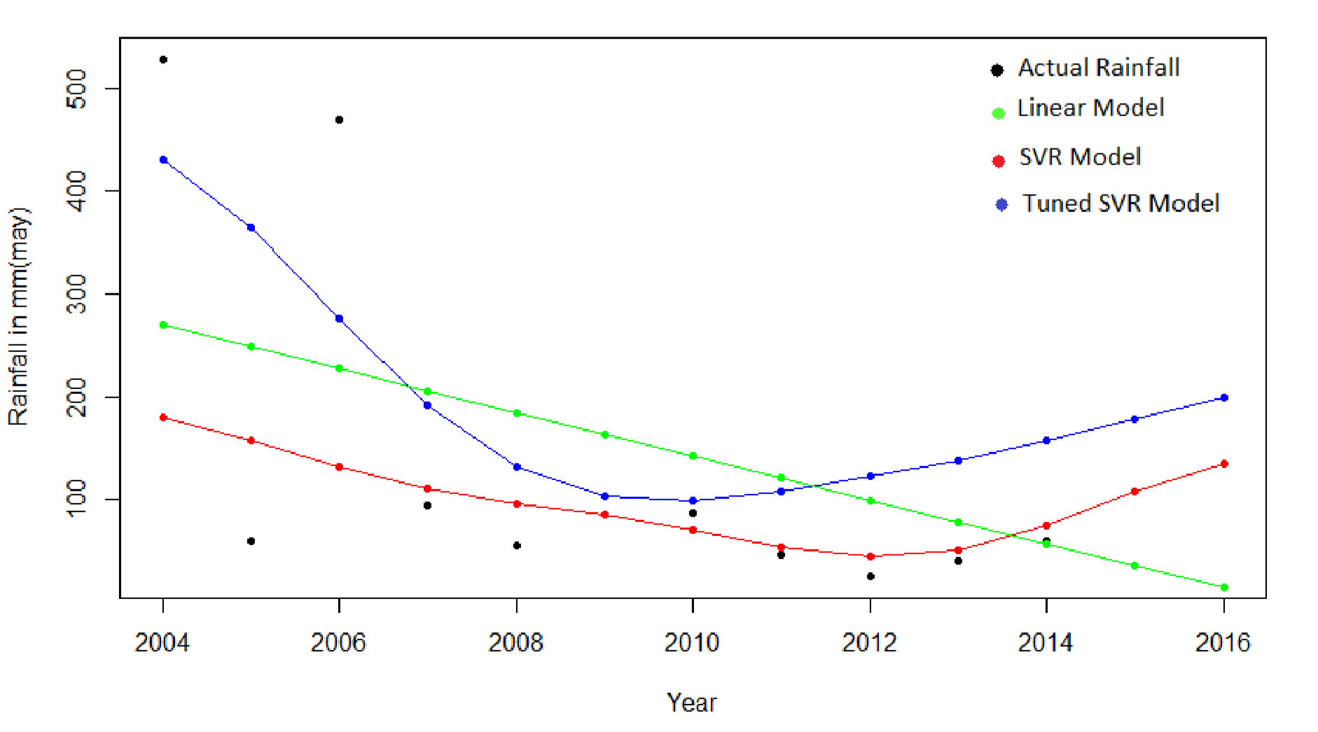
RESULT

Slide 8
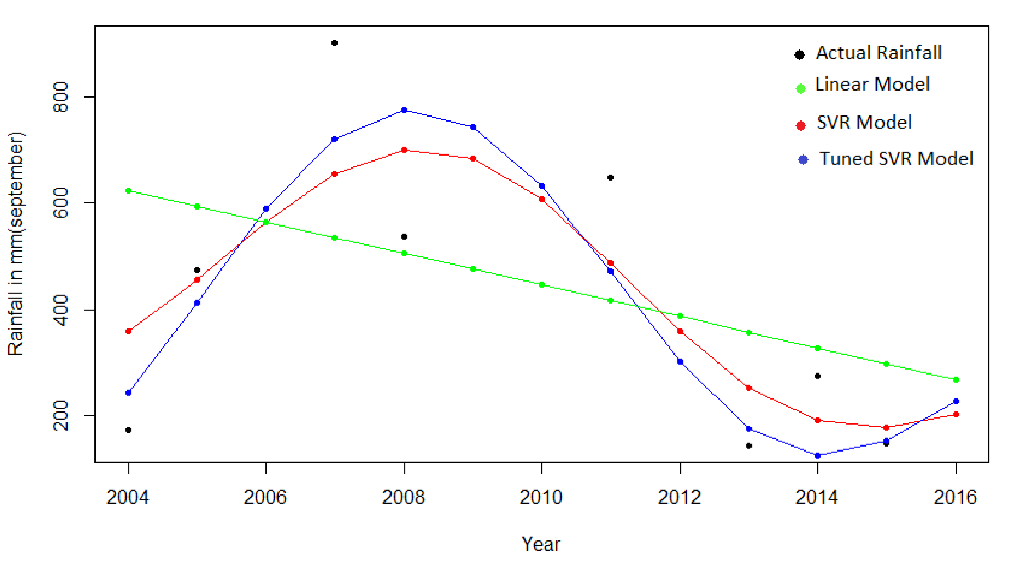

Slide 9
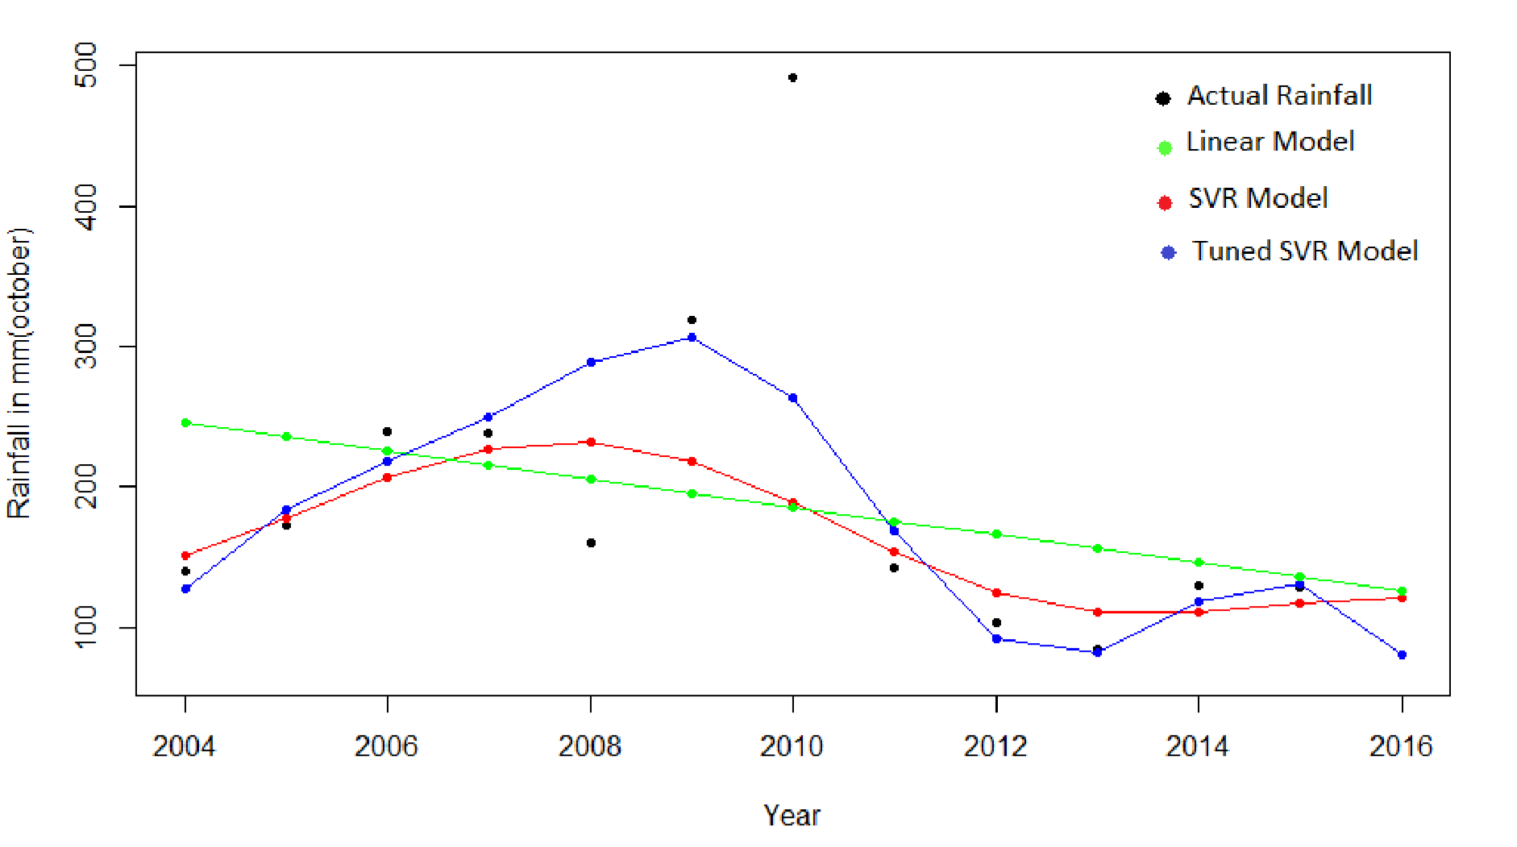

Slide 10
Table 1 : Predicted values using different models
Month-Year | Actual Rainfall (mm) | Linear Model Prediction (mm) | SVR Model Prediction (mm) | Tuned SVR Model Prediction (mm)
May’15 | 159.97 | 35.615 | 107.669 | 119.997
May’16 | 119.16 | 14.33 | 135.447 | 119.166
September’15 | 149.87 | 298.665 | 178.557 | 152.235
September’16 | 228.07 | 269.128 | 203.097 | 228.071
October’15 | 128.55 | 135.766 | 116.987 | 131.73
October’16 | 69.31 | 125.712 | 121.634 | 80.786

Slide 11
Table 2: RMSE of different models
Table 4.2.2 RMSE Values of different models
Month | RMSE (Linear Model) | RMSE (SVR Model) | RMSE (Tuned SVR Model)
May | 114.591 | 34.593 | 9.99
September | 94.927 | 26.83 | 7.328
October | 31.807 | 31.945 | 1.182

Slide 12
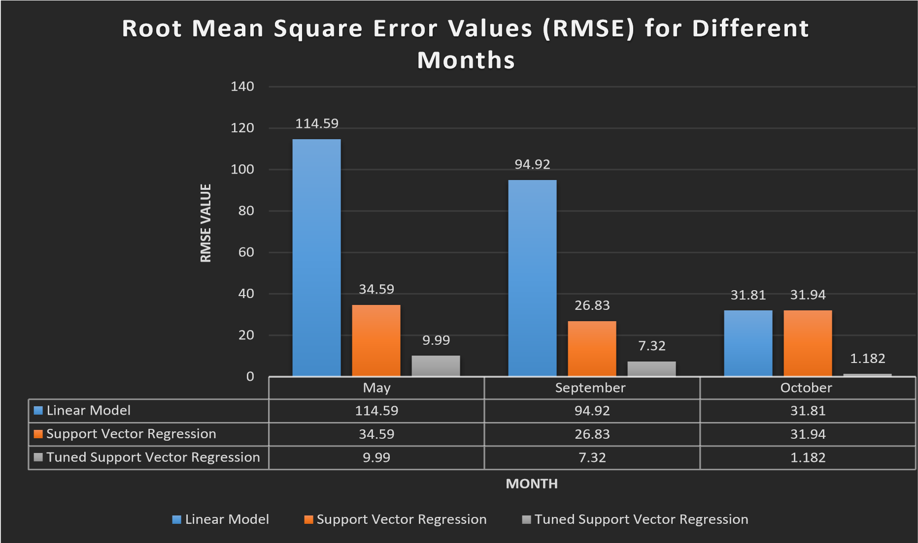

Slide 13
CONCLUSION
Prediction using SVM is much simpler than other methods such as ANN which requires complex data set.
SVR model when tuned with parameters (C and ℇ) is able to predict accurately when compared to Linear Model and SVR Model.
Tuned SVR Model can be used for weather forecasting because of its precision.

Slide 14
Time Line
January 2017 | Literature Survey
February 2017 | Collection of secondary data Learning SVM Implementation of basic code
March 2017 | To develop SVM based prediction model Testing Performance Analysis
April 2017 | Parameter Optimization of SVM using GA Performance analysis
May 2017 | Documentation
14

Slide 15
References
1. “Support vector machine”.
<http://en.wikipedia.org/wiki/Support_vector_machine> (4/6/2011) Jason Weston, “Support Vector Machine (and Statistical Learning Theory) Tutorial”, NEC Labs America.
2. Pijush Samui1, Venkata 2. Ravibabu Mandla, Arun Krishna and Tarun Teja,” Prediction of Rainfall Using Support Vector Machine and Relevance Vector Machine”, IEEE Eart Science India, vol 4,October 2011.
3. Mr.dhawal hirnai ,dr. nitin Mishra ,” A Survey On Rainfall Prediction Techniques “, International Journal of Computer Application (2250-1797) Volume 6– No.2, March- April 2016 .
4. Drucker, H. Burges, C. Kaufman, L. Smola A & Vapnik, V. 1997. “Support vector regression machines, Advances in Neural Information Processing systems”. MIT press, Cambridge, MA 156-161.
5. Pallavi and Garima Singh, “Review on Rainfall Forecasting Using Different Techniques and Algorithms”. International Journal of Innovative Research in Computer and Communication Engineering (An ISO 3297: 2007 Certified Organization) Vol. 4, Issue 3, March 2016
6. Ganesh P. Gaikwad, Prof. V. B. Nikam “Different Rainfall Prediction Models And General Data Mining Rainfall Prediction Model” International Journal of Engineering Research & Technology (IJERT) ISSN: 2278-0181 Vol. 2 Issue 7, July – 2013
7. Divya Chauhan Jawahar Thakur Data Mining Techniques for Weather Prediction: A Review In International Journal on Recent and Innovation Trends in Computing and Communication(IJRITCC) ISSN: 2321-8169 2184 – 2189 Volume: 2 Issue: 8.
15

